Slide 1

A22
温家伟

Slide 2


Slide 3


Slide 4
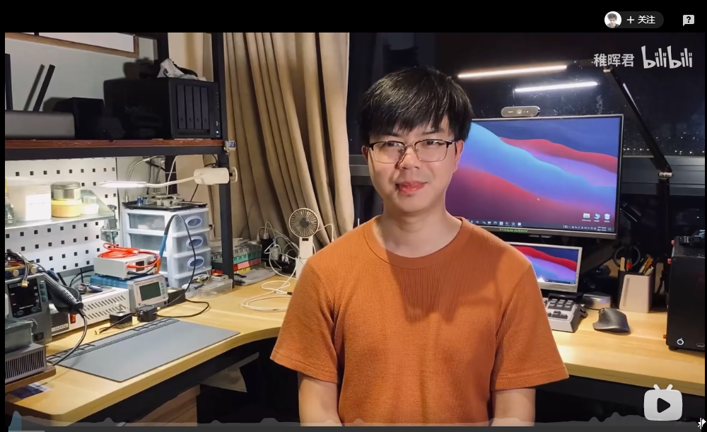
AN UPLOADER OF BILIBILI STATION

Slide 5
稚晖君

Slide 6

introduction
彭志辉
毕业于电子科技大学
华为天才少年
B站up主
……

Slide 7
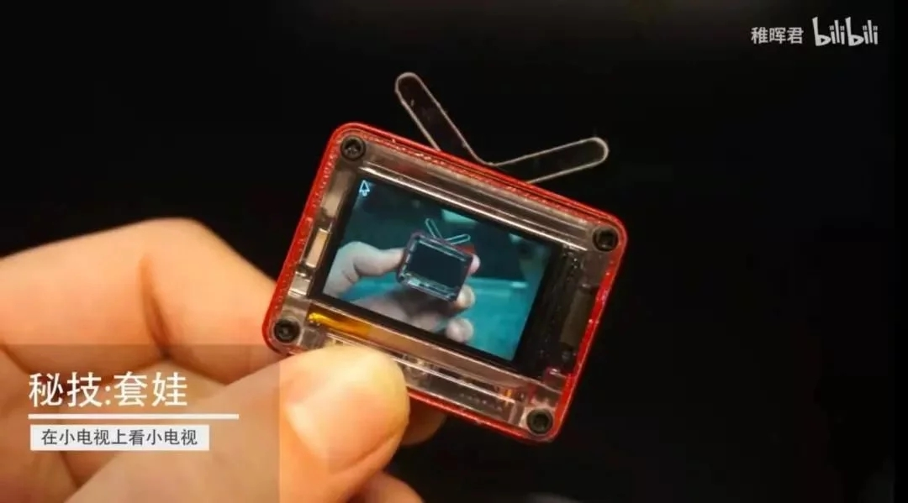
Small television

Slide 8
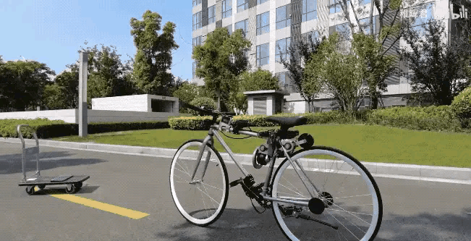
Balance bike

Slide 9
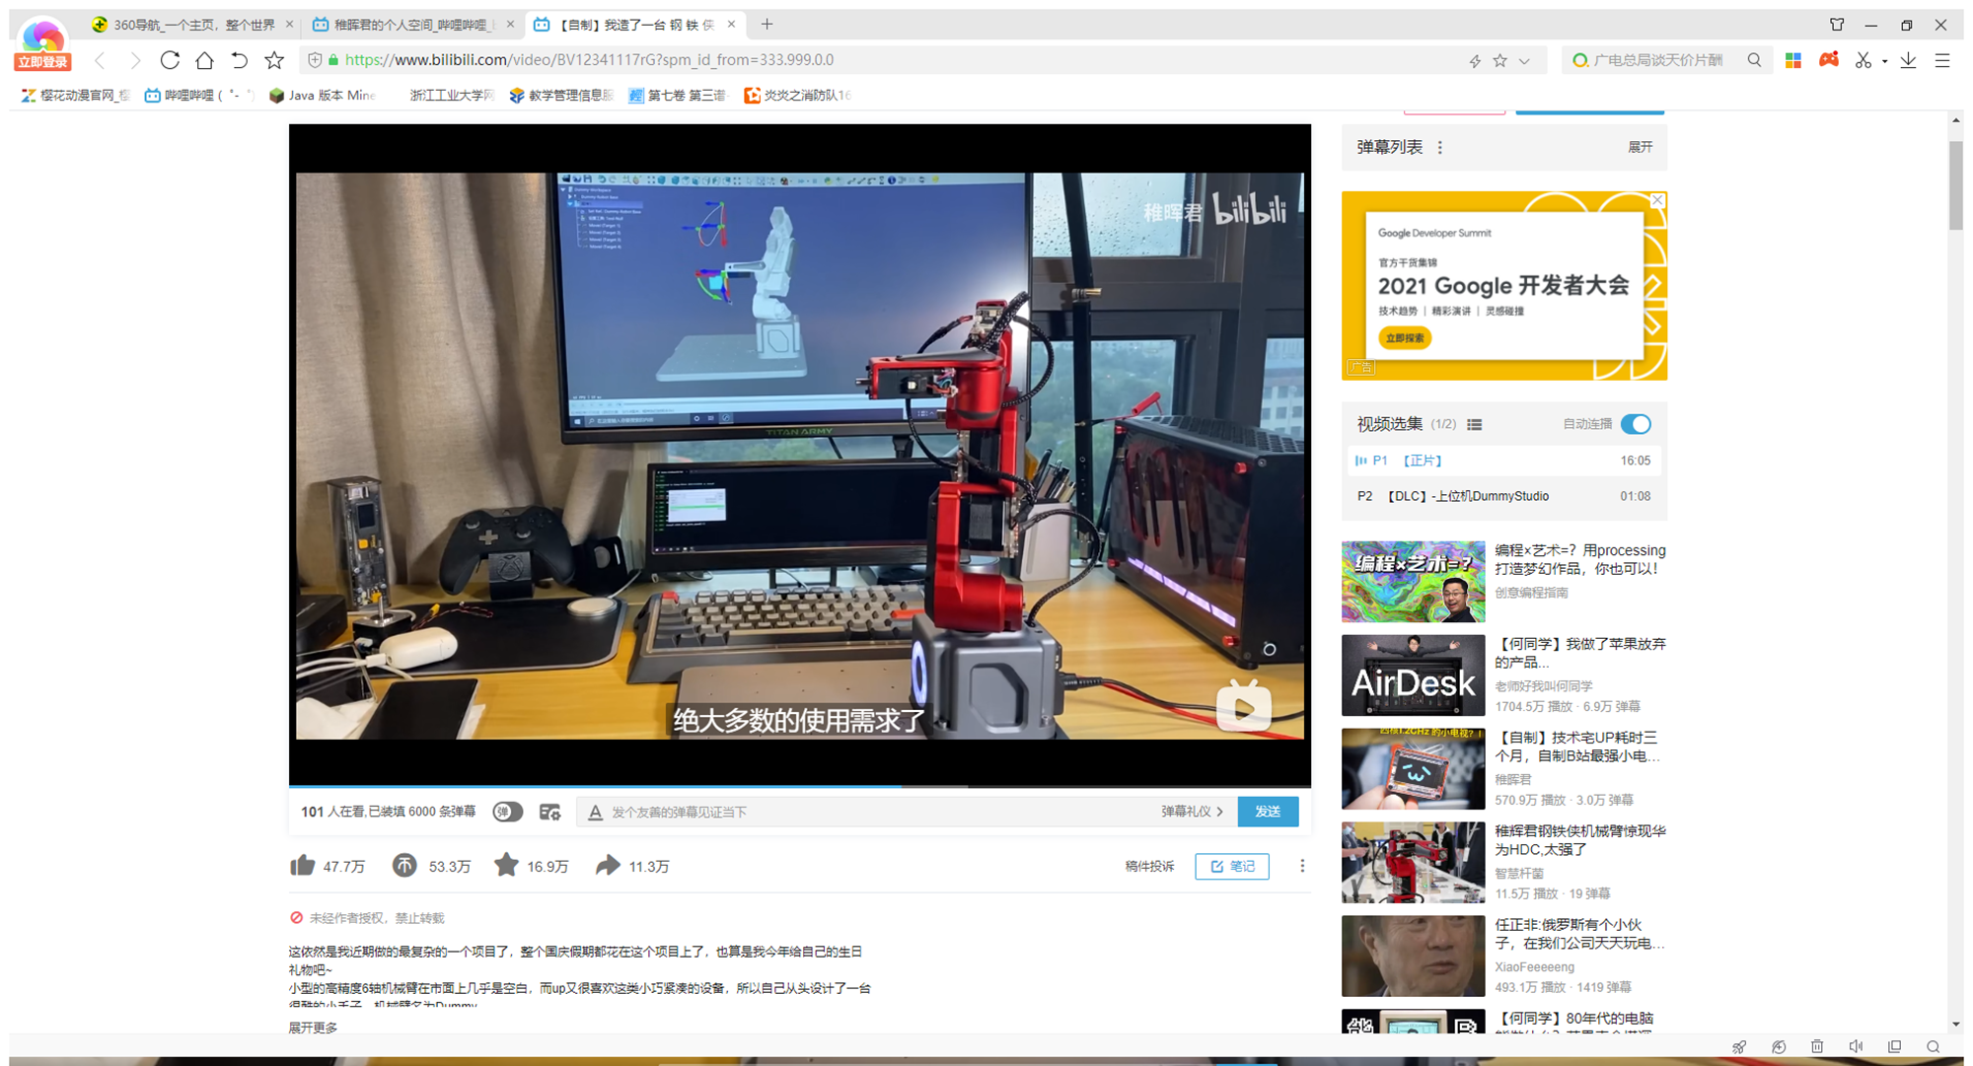
Mechanical arm

Slide 10
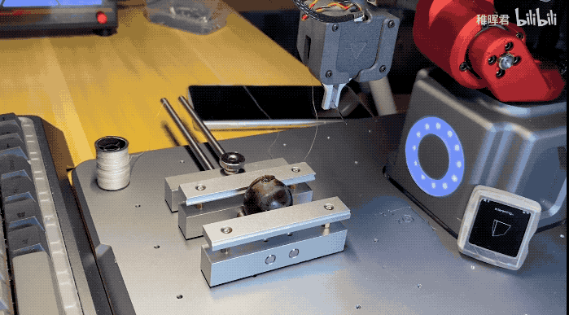
Sewing grapes

Slide 11
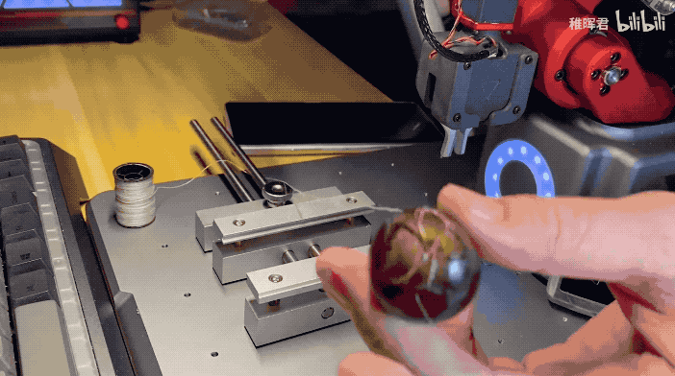
Sewing grapes

Slide 12
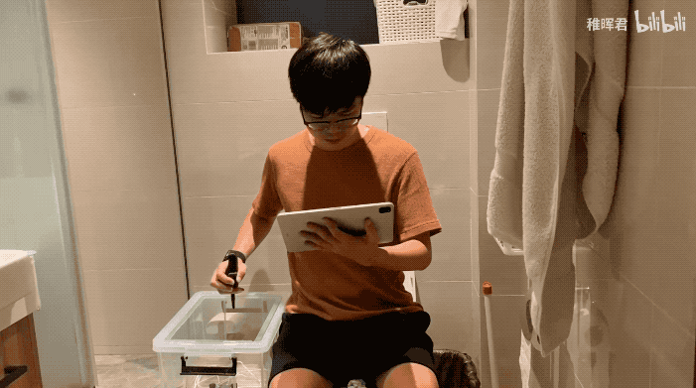
Remote manipulation

Slide 13
Thanks for your listening.

